Slide 1
Artificial Agriculture Officer
Project Guide: B. Lokesh Joel
By: Hiranmai Natuva (160114733128)
Charishma Ravoori (160114733186)

Slide 2
Contents
Problem Definition
Literature Survey
Methodology
Design
Implementation
Results
Conclusion
References

Slide 3
Problem Definition
There are loads of data regarding agriculture in the world that is hard to navigate through.
The internet provides long and sometimes irrelevant answers.
Farmers may be illiterate.
Goal: To build an app that solves all the above problems.

Slide 4
Literature survey
Sno | Title | Authors | Description
1 | AGRI-QAS question-answering system for agriculture domain | Sharwari Gaikwad, Rohan Asodekar, Sunny Gadia, and Vahida Z. Attar | This system aims to help farmers get information and resolve their queries related to agriculture and thereby improving agriculture literacy. The system is based on the principles of natural language processing and information retrieval.
2 | A Review on Speech Recognition Challenges and Approaches | Vimala.C and Dr.V.Radha | This paper is a discussion about the various challenges of speech recognition and the various approaches to solve this problem
3 | Effective Question Answering Techniques and their Evaluation Metrics | Jaspreet Kaur and Vishal Gupta | This paper is a discussion about question answering systems and various methods of answer retrieval

Slide 5
Methodology
First the user must be authenticated.
Then the user poses a question verbally to the application
This question is processed by the application and is converted to text
The query is then sent to the dialogflow.

Slide 6
Following a set of data and rules, we have defined, the dialogflow module provides the appropriate response to the user’s question.
The response is sent back to the application, converted to speech, and returned to the user.

Slide 7
implementation
MODULES
Authentication
Speech to Text
DialogFLow
Text to speech
Image Recognition

Slide 8
Authentication
Firebase is a tool that offers many different facilities, of which one is user authentication using phone numbers.

Slide 9
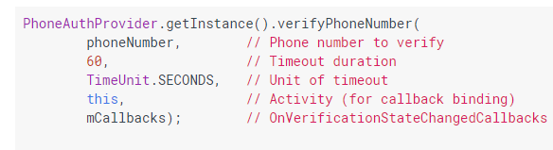
Authentication
Verify phone number using SMS code
A verification callback function is invoked
PhoneAuthCredential object is created
Sign in
Loggout

Slide 10
Speech to Text
We are triggering an Intent named RecognizerIntent which asks for speech input and then sends it through speech recognizer.
It does it through ACTION_RECOGNIZE_SPEECH.
If request code is REQ_CODE_SPEECH_INPUT then corresponding text is written in the output screen.

Slide 11
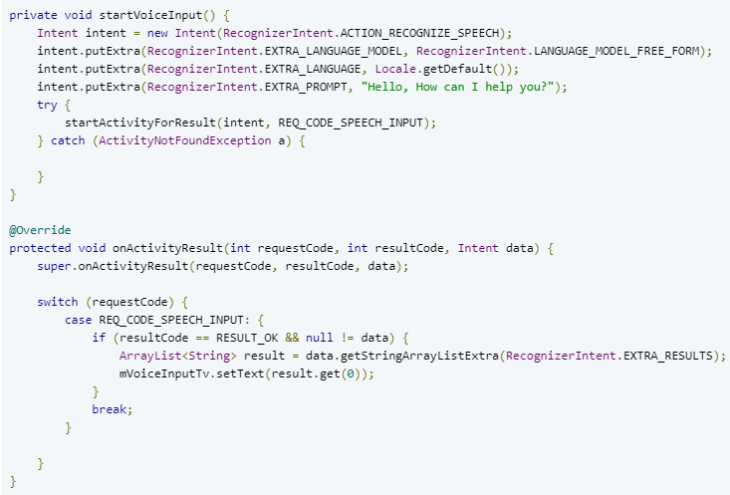

Slide 12
DialogFlow
The DialogFlow tool allows us to store data and create a flow of dialog.
Intents
Entities
Contexts

Slide 13
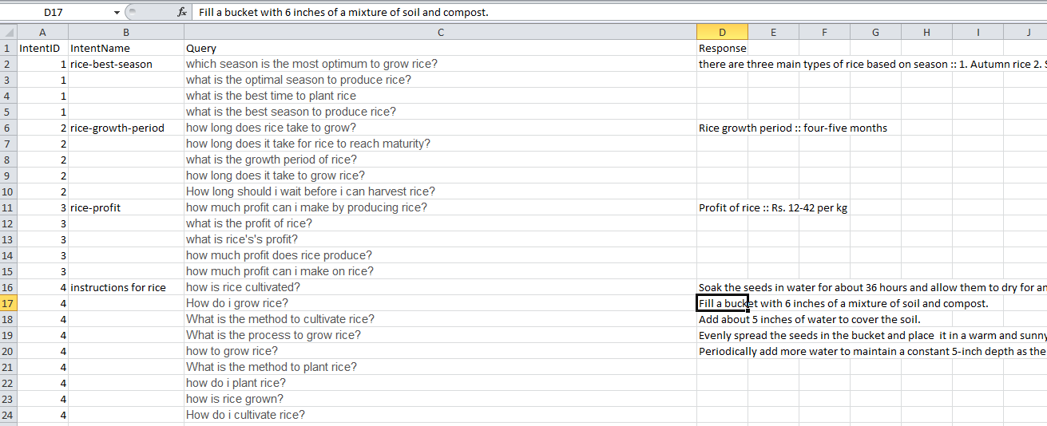
dialogflow
Information gets fed into Dialogflow using a .csv dataset. This file must be converted to .txt before it can be uploaded.

Slide 14
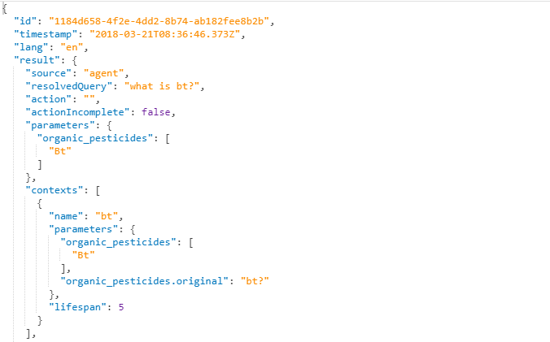
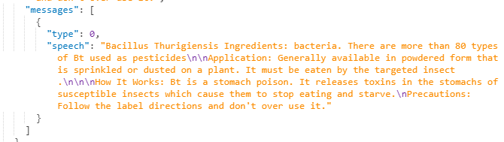
The query data gets stored as a JSON object

Slide 15
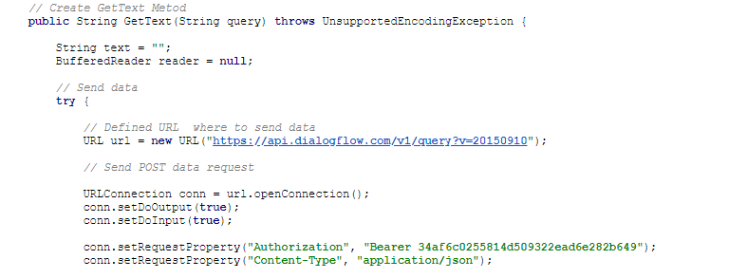
Dialogflow
Connecting to api.ai

Slide 16
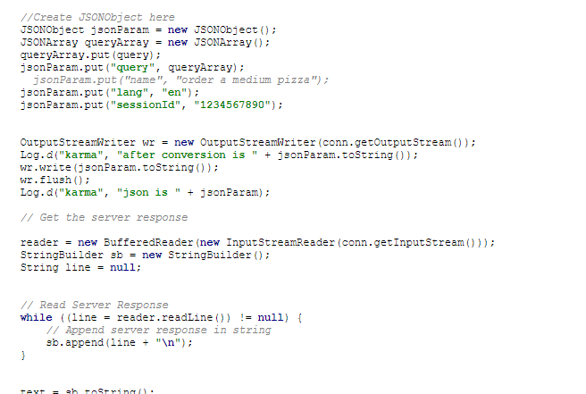
Dialogflow
Getting/Reading Server Responses

Slide 17
Image recognition
Approach: Supervised Learning
Technique: Artificial Neural Network
Tensorflow and Transfer Learning
Inception V3 and Mobilenet
Our dataset
Training: Bottlenecks and Training

Slide 18
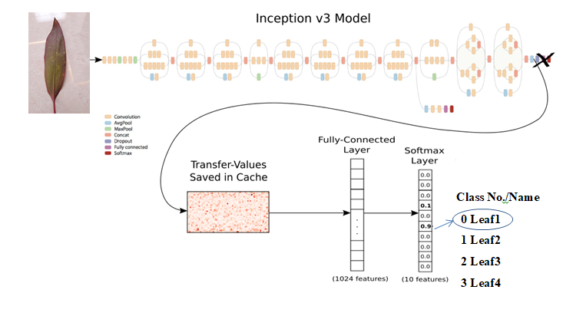
Image Recognition
Image Recognition is implemented using Tensorflow, a tool that allows for “transfer learning.”

Slide 19
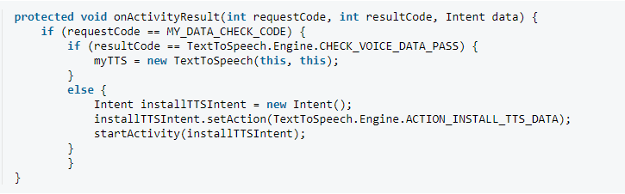
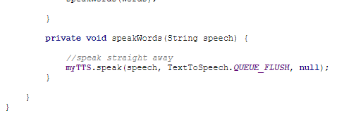
Text to Speech

Slide 20
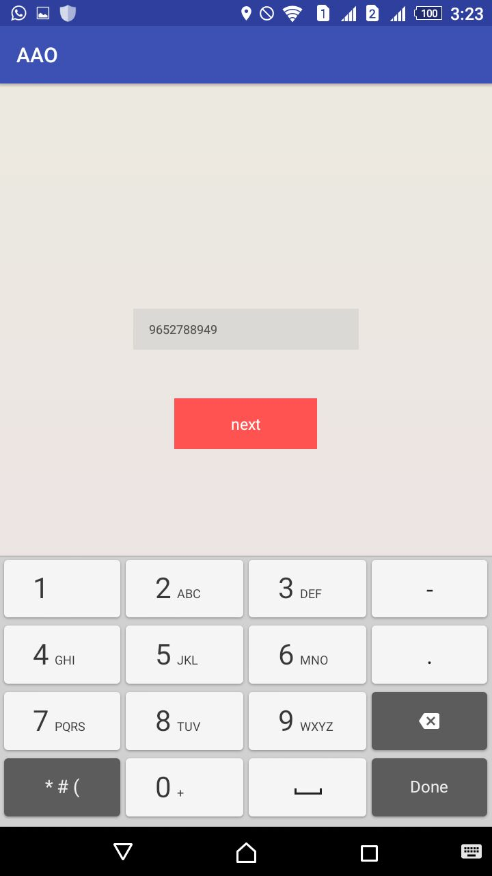
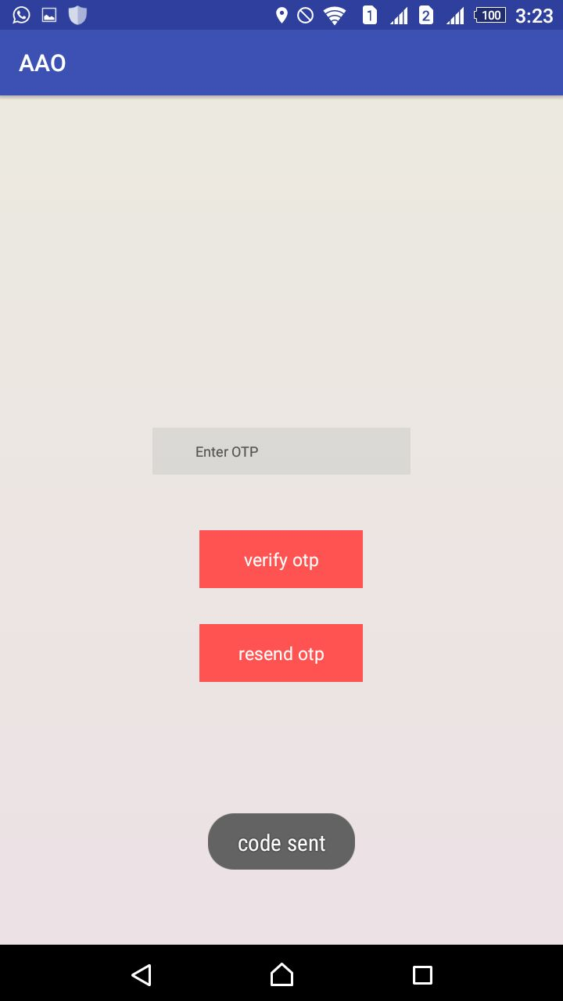
Results
Authentication

Slide 21
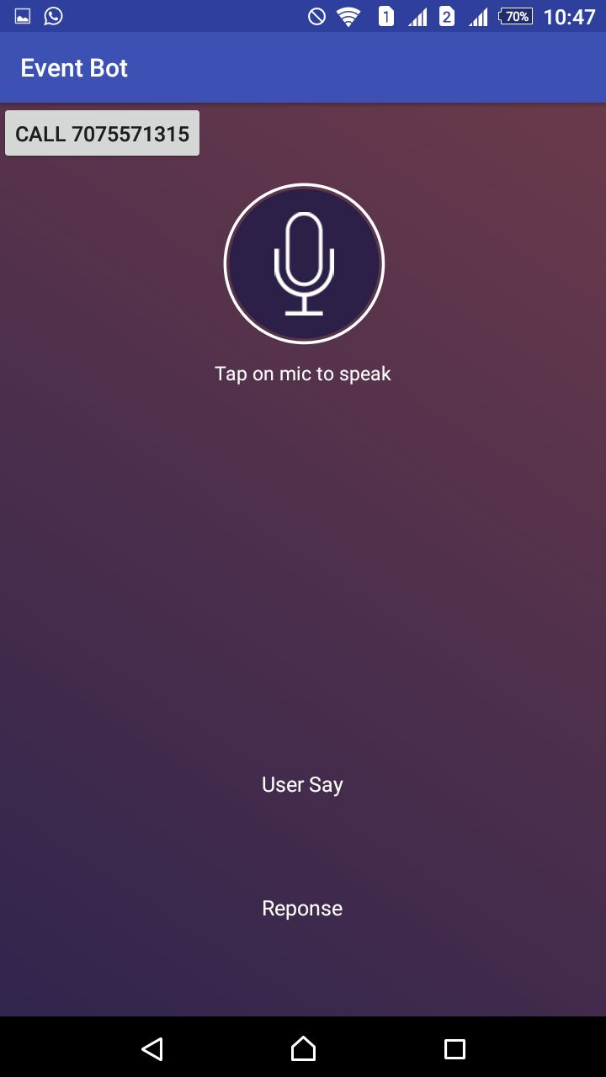
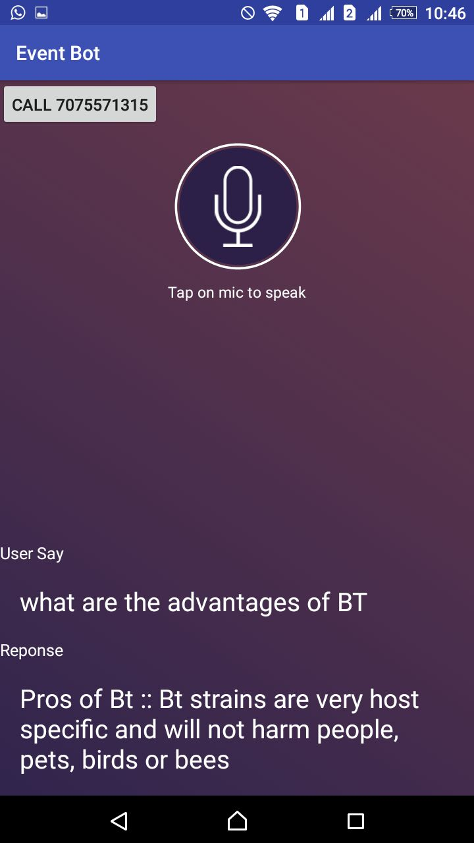
Results
Speech recognition, dialogflow and text to speech

Slide 22
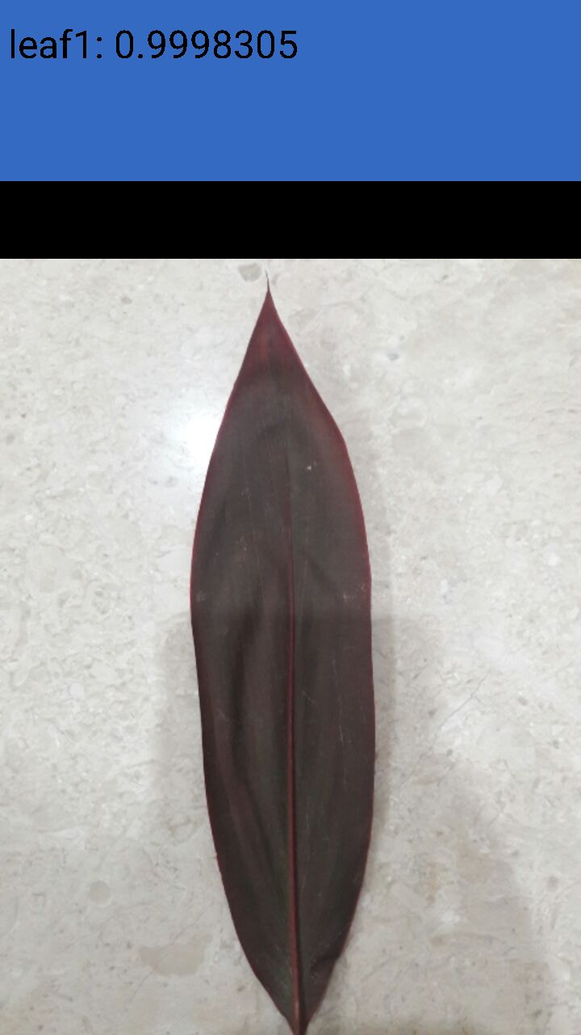
results
Image Recognition

Slide 23
Conclusion
We have completed the application development, dialogflow, and speech recognition aspects of the project.
We still have to expand our database and we are planning to add an image recognition aspect as well.

Slide 24
References
[1] Dialogflow documentation : https://dialogflow.com/docs/getting-started/basics
[2] Sharwari Gaikwad, Rohan Asodekar, Sunny Gadia, and Vahida Z. Attar, “AGRI-QAS question-answering system for agriculture domain,” in Advances in Computing, Comunications and Informatics (ICACCI), 2015 International Conference.
[3] Sharwari Gaikwad, Rohan Asodekar, Sunny Gadia, and Vahida Z. Attar, “AGRI-QAS question-answering system for agriculture domain,” in Advances in Computing, Comunications and Informatics (ICACCI), 2015 International Conference.
[4] Santosh K.Gaikwad, Bharti W.Gawali and Pravin Yannawar, “A Review on Speech Recognition Technique”, International Journal of Computer Applications (0975 – 8887) Volume 10– No.3, November 2010
[5] Android reference : https://github.com/dialogflow/dialogflow-android-client
[6] Speech-to-text/ Text-to-speech : http://stacktips.com/tutorials/android/speech-to-text-in-android

Slide 25
THANK YOU!!

